Slide 1

Bangladesh Army International University Of Science And Technology
Title
Handwritten And Printed Bengali Script Character Segmentation Using Morphological Analysis
Supervised By: Arifa Islam Champa Lecturer Department of CSE,BAIUST
Presented By: Pritilata Biswas ID: 1103017
Sumaia Afrin Prity ID: 1103057
Parvez Abedin Siddique ID: 1103094
Department of CSE,BAIUST

Slide 2

Outline
Introduction
Motivation
Challenges
Objective
Literature Review
Methodology
Implementation
Result Analysis
Conclusion
Limitations
Future Scope
References

Slide 3
Introduction
OCR is a major research area
Segmentation is the most challenging part
Need a robust technique for segmentation

Slide 4
Challenges
For Bengali script, no good OCR
OCR is the key tool
Script segmentation is the most challenging task

Slide 5
Motivation
Printed text OCR have a huge success but handwritten still need to improved
Major problem – removing connectedness

Slide 6
Objective
Effective strategy for segmenting Bengali scripts
Reduce the segmentation error and time

Slide 7
Literature Review
Segmentation of Bengali handwritten text into characters by recursive contour following by Bishnu and Choudhury[1]
Got fairly good results if the sequent characters are not touching in the zone of contour following
Segmenting Bangla Text for Optical Recognition by Sattar[2]
Examined the width of a single character sufficiently

Slide 8

Methodology
Bengali Script
Word Segmentation
Line Segmentation
Preprocessing
Character Segmentation
Figure 1: Methodology.

Slide 9
Preprocessing
Bilateral Filtering
Gray Scale Filtering
Binarization
Figure 2: Preprocessing steps.

Slide 10
Line Segmentation
Horizontal Projection
Profile
Projection profile of an image along horizontal axis
Calculated for every row
Sum of all column pixel values inside the row
Figure 3: Line Segmentation using HPP [3].

Slide 11
Word Segmentation
Vertical
Projection
Profile
Projection profile of an image along vertical axis
Calculated for every column
Sum of all row pixel values inside the column
Figure 4: Word Segmentation using VPP [3].

Slide 12
Character Segmentation
Morphological Opening Operation
Morphological Closing Operation
Vertical
Projection
Profile
Figure 5: Character segmentation steps.

Slide 13
Morphological Image Processing
Binary images may contain numerous imperfections
Removes these imperfections
Collection of non-linear operations
Erosion, Dilation, Opening, Closing
Related to the shape [4]
Vertical
Projection
Profile

Slide 14



Morphological Image Processing
Opening Operation
Closing Operation
Removes pixels from the edge
Adds pixels from the edge
(a) Input Image
(b) After opening[5]
(c) After closing[6]
Figure 6: Morphological Image Processing.

Slide 15
Dataset
Book
আবারো টুনটুনি ও আবারো ছোটাচ্চু - Muhammed Zafar Iqbal
Scanner
HP Desk Jet Ink Advantage 4675 All-in-One Printer
Scanned in 300 dpi
Wrote lines from the same book in A4 pages
Vertical
Projection
Profile

Slide 16
Result Analysis Preprocessing (Printed Script)
(a) Input Image
(b) Applying Grayscale filter
(c) Applying Bilateral filter
(d) Image Binarization
Figure 7: Preprocessing for Bengali printed script.

Slide 17
Result Analysis Preprocessing (Handwritten Script)
(a) Input Image
(b) Applying Grayscale filter
(c) Applying Bilateral filter
(d) Image Binarization
Figure 8: Preprocessing for Bengali handwritten script.

Slide 18
Result Analysis Line Segmentation
(a) Handwritten Script
(b) Printed Script
Figure 9: Line segmentation of Bengali script using HPP.

Slide 19
Result Analysis Word Segmentation
(a) Handwritten Script
(b) Printed Script
Figure 10: Word segmentation of Bengali script using VPP.

Slide 20
Result Analysis Character Segmentation
(a) Handwritten Script
(b) Printed Script
Figure 11: Character segmentation of Bengali script using VPP.

Slide 21
Tesseract OCR Engine
Works in various environments
Developed by the HP
Supported in 100+ languages
Widely used in most complicated OCR tasks

Slide 22
Result Analysis Comparison with Tesseract OCR Engine
(a) Output from our system
(b) Output from the Tesseract OCR engine
Figure 12: Comparing of character segmentation with Tesseract OCR engine.

Slide 23
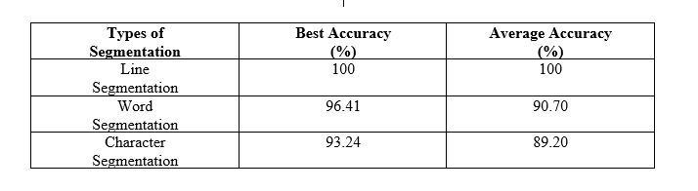
Accuracy
Table 1: Overall best accuracy and average accuracy of our system on printed script.

Slide 24
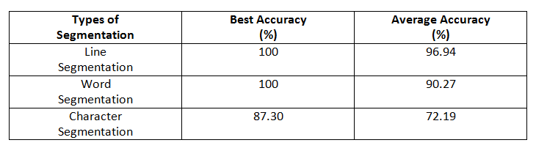
Accuracy
Table 2: Overall accuracy and average accuracy of our system of handwritten script.

Slide 25
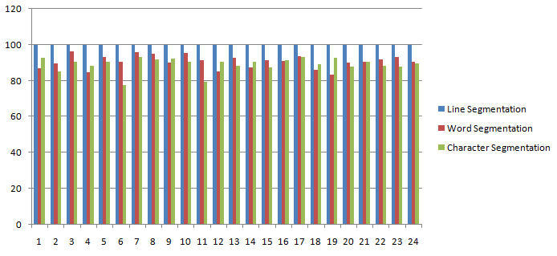
Accuracy Graph
Figure 12: Line segmentation, Word segmentation and Character segmentation of printed script.

Slide 26
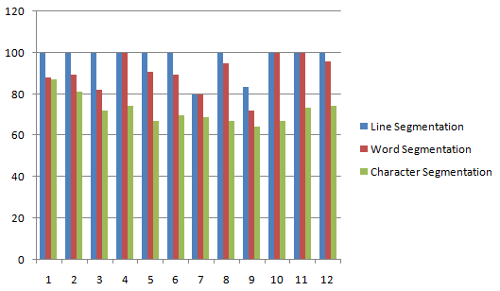
Accuracy Graph
Figure 12: Line segmentation, Word segmentation and Character segmentation of handwritten script.

Slide 27
Conclusion
Mainly focused on the segmentation
Line, Word and Character Segmentation
A good accuracy of our system

Slide 28
Limitations
More than 30 degree skewed lines
Inter-word gap equal to the inter-character gap
Overlapped characters

Slide 29
Future Scope
We have a plan to use HMM (Hidden Markov model)

Slide 30
References
A. Bishnu, B.B. Chaudhuri (1999) “Segmentation of Bangla handwritten text into characters by recursive contour following”, Proceedings of the Fifth International Conference on Document Analysis and Recognition. ICDAR '99: IEEE.
Md. Abdus Sattar, Khaled Mahmud, Humayun Arafat and A. F. M.Noor Uz Zaman, “Segmenting Bangla Text for Optical Recognition, ”ICCIT, 2007. ISBN: 978-1-4244-1550-2, pp. 1-6.
T. Zahan, M.R. Selim, M.S. Rahman, M.Z. Iqbal, (2018). “Connected Component Analysis Based Two Zone Approach for Bangla Character Segmentation.” 1-4.10.1109/ICBSLP.2018.8554684.

Slide 31
References
J. H. Bosworth, S. T. Acton, “Morphological scale-space in image processing”, Digital Signal Processing, Volume 13, Issue 2, 2003, Pages 338-367, ISSN 1051-2004, https://doi.org/10.1016/S1051-2004(02)00033-7.
https://homepages.inf.ed.ac.uk/rbf/HIPR2/open.html
https://homepages.inf.ed.ac.uk/rbf/HIPR2/close.html

Slide 32
Thank you
Any Questions?

